Slide 1

AN UNCONVENTIONAL START:
OPEN SOURCE
HOW
OPENED MY OPPORTUNITIES
Mars Lee, 14 September 2022
RSE Asia Australia Unconference
Early Career Keynote
Notes:
Hi everyone! I’m Mars, and I’m one of the joint speakers for the RSE Asia Australia Unconference, Early Career Keynote. My keynote title is: An Unconventional Start: How Open Source Opened my Opportunities

Slide 2


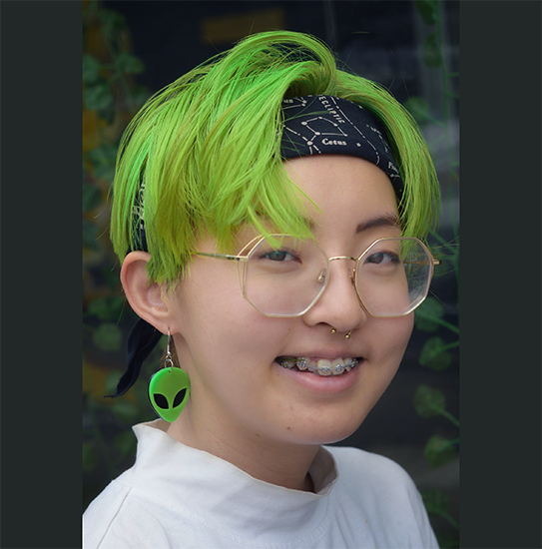


MARS LEE
Technical Illustrator at Quansight
Notes:
Quick introduction: I’m Mars Lee. A short visual description of the visually impaired: I have green hair and a dangly alien earring! I’m a technical illustrator at Quansight. I’m from South Korea and Singapore. Fun fact: I rollerskate!

Slide 3


MARS LEE
Open Source Contributor
Notes:
I also contribute to 2 open source projects: NumPy and Open Source Design

Slide 4
WOAAAAAAHH
Who is this mysterious person?
Why are they giving a keynote?
What’s a Technical Illustrator?
Notes:
At this point, you’re probably thinking “woooaaah!”: Who is this mysterious person? Why are they giving a keynote? What’s a Technical Illustrator?

Slide 5
WOAAAAAAHH
Who am I?
Am I qualified to give a keynote?
Yeah…What is a Technical Illustrator?
Notes:
To be honest, I’m thinking the same thing. Who am I? Am I qualified to give a keynote? Yeah…What is a Technical Illustrator?

Slide 6
PURPOSE OF AN
EARLY CAREER
KEYNOTE
Be ~ inspirational ~
Explain how you got here
Give advice so others can get where you are
Notes:
When I asked go give an early career keynote, I made some assumption of what to do.

Slide 7
PURPOSE OF AN
EARLY CAREER
KEYNOTE
What inspired me?
How did I get here?
Who helped me?
Notes:
So I asked myself: What inspired me? How did I get here? And Who helped me?

Slide 8
PURPOSE OF AN
EARLY CAREER
KEYNOTE
Notes:
Once I started thinking beyond myself, I saw the connections so much more clearly!

Slide 9
PURPOSE OF AN
EARLY CAREER
KEYNOTE
Recognize community and mentorship as foundational to where I am today
Connect newcomers to wonderful open source projects
Encourage more diverse contributions to
open source research software
Notes:
So for me, the purpose of this keynote is to Recognize community and mentorship as foundational to where I am today, Connect newcomers to wonderful open source projects, Encourage more diverse contributions to open source research software.

Slide 10
OVERVIEW
MY UNCONVENTIONAL START
01
College drop-out. I have 0 PhDs!
OVERCOMING INSECURITIES
02
... what is an artist doing here?
FINDING STRENGTH AND SUPPORT
03
Understanding processes and getting comfortable!
MY UNCONVENTIONAL CONTRIBUTIONS
04
‘How to Write Alt Text’ Comics, NumPy Comics,
‘Your Contributor Adventure’ and more!
Notes:
Here’s a quick overview. The first half is about gow I started, overcoming insecurities, finding strength and support and then showing off my unconventional contributions.

Slide 11
OVERVIEW
HOW YOU CAN START
05
Whether you have a Bachelor, Masters, PhD or none of the above!
OVERCOMING YOUR INSECURITIES
06
The secret: We’re all figuring it out!
FINDING STRENGTH AND SUPPORT
07
Connect with fellow newcomers and mentors
YOUR UNCONVENTIONAL CONTRIBUTIONS
08
How can you contribute to open source differently?
Notes:
The second part is a mirror, reflected back at you, dear audience member. How you can start, overcome your insecurities, find your strength and contributions!

Slide 12
MY UNCONVENTIONAL START
01
 | EXPECTED PROFILE |  | ME
Software Engineer | ✓
In academia | X
Knows the ins and out of their favorite open source software before becoming a contributor | ✓
Notes:
Part 1: My unconventional start. You might have in mind what a open source, research contributor is like. A software engineer, maybe with 2 PhDs, and an expert on open source software before their first contribution. Me? I’m none of those things.

Slide 13
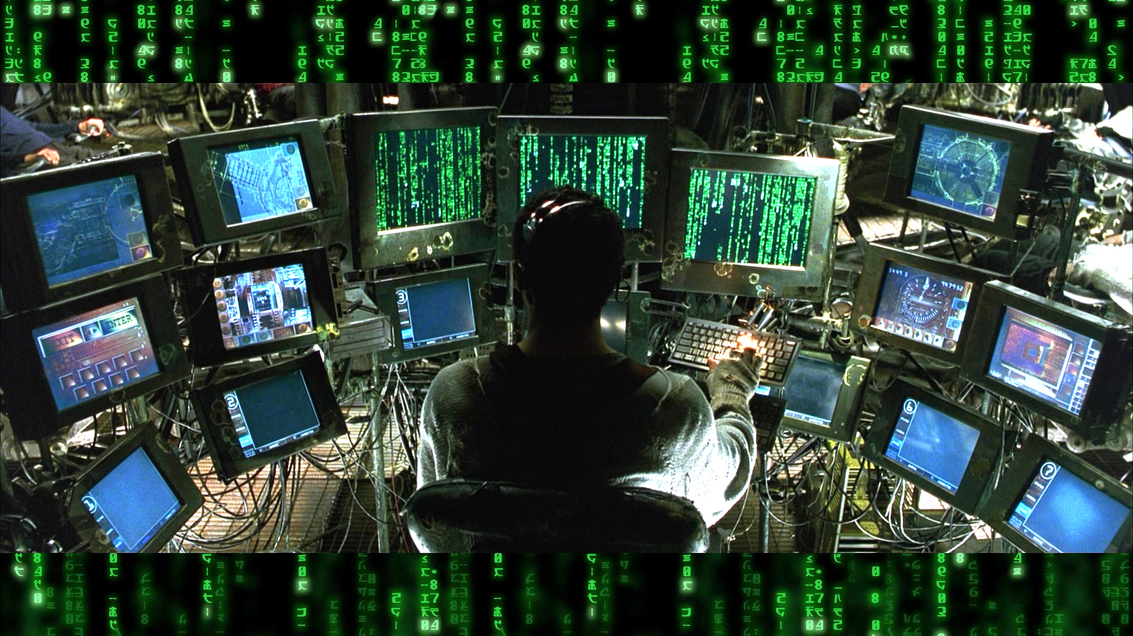
MY UNCONVENTIONAL START
01
 | EXPECTED PROFILE
Software Engineer | ✓ |  | X
In academia | X |  | ✓
Knows the ins and out of their favorite open source software before becoming a contributor | ✓ |  | X
Notes:
I thought you needed to be this, plugged into the Matrix to start.

Slide 14
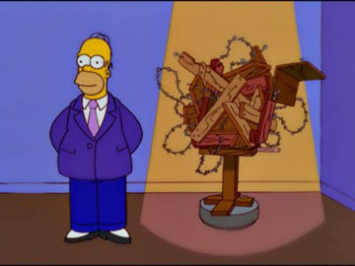
MY UNCONVENTIONAL START
01
Software Engineer | ✓ |  | X
In academia | X |  | ✓
Knows the ins and out of their favorite open source software before becoming a contributor | ✓ |  | X
Notes:
Little ol’ me, got none of those things.

Slide 15
MY UNCONVENTIONAL START
01
 | ME
Artist
College drop-out
Google searched “free alternative to photoshop please?”
Notes:
What I am, are these things: i’m an artist, a college/university drop-out and google searched “free alternative to photoshop please?” because adobe software can be … pricey.

Slide 16

OVERCOMING INSECURITIES
02
 | ME
Artist
College drop-out
Google searched “free alternative to photoshop please?”
Notes:
Part 2. I had all these insecurities of who I was, as I entered the open source space.

Slide 17
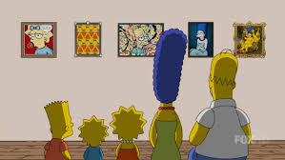
OVERCOMING INSECURITIES
02
 | ME
Different and equally valuable skill-set
Not letting arbitrary measures of success determine what I can do
Everyday user of open source software
Notes:
But I thought to myself, what if these are strengths, not weaknesses? What if i viewed myself as having a Different and equally valuable skill-set? Not letting arbitrary measures of success like degrees determine what I can do. And that I am Everyday user of open source software.

Slide 18
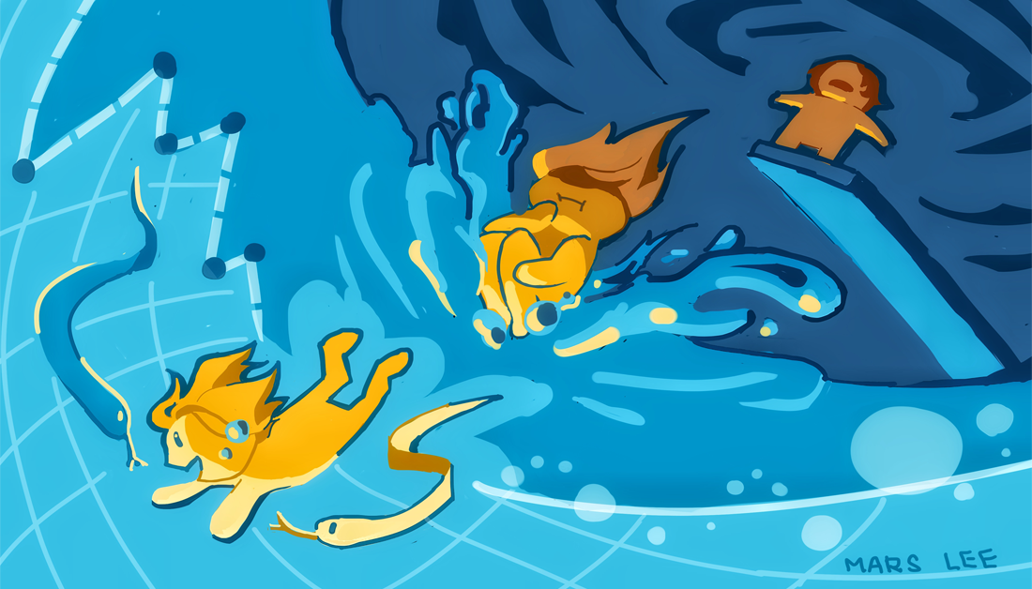
OVERCOMING INSECURITIES
02
My Unexpected Dive into Open-Source Python
1 February 2020
Notes:
If you would like to read my blog post of my start, you can check it out here. The link will be posted in the chat.

Slide 19
03
FINDING STRENGTH AND SUPPORT
Notes:
Part 3: Finding strength and support. Even if I had changed my mindset, I still wasn’t sure how to actually make things. To actually contribute.

Slide 20
03
FINDING STRENGTH AND SUPPORT
Notes:
But then I connected to communities! Actual people.

Slide 21
03
FINDING STRENGTH AND SUPPORT
Open Source Design
Mentors +
NumPy Contributor Experience Lead
Going to community calls (even when absolutely had no idea what was going on)
Trying- and failing- and trying again to make my first contribution
Asking for help
Fellow contributors
Notes:
I found fellow designers in the Open Source Design community. I had mentors and experience leads in NumPy. I hung out with fellow contributors. Went to community calls even when I was completely lost, failed many times and asked for help many times.

Slide 22
MY UNCONVENTIONAL CONTRIBUTIONS
04
 | ME
Different and equally valuable skill-set
Not letting arbitrary measures of success determine what I can do
Everyday user of open source software
Notes:
Once I changed my mindset and connected to community, I was ready to contribute. Remember this slide earlier? Well now that I’m charged up, in Super Saiyan mode, I went for it.

Slide 23
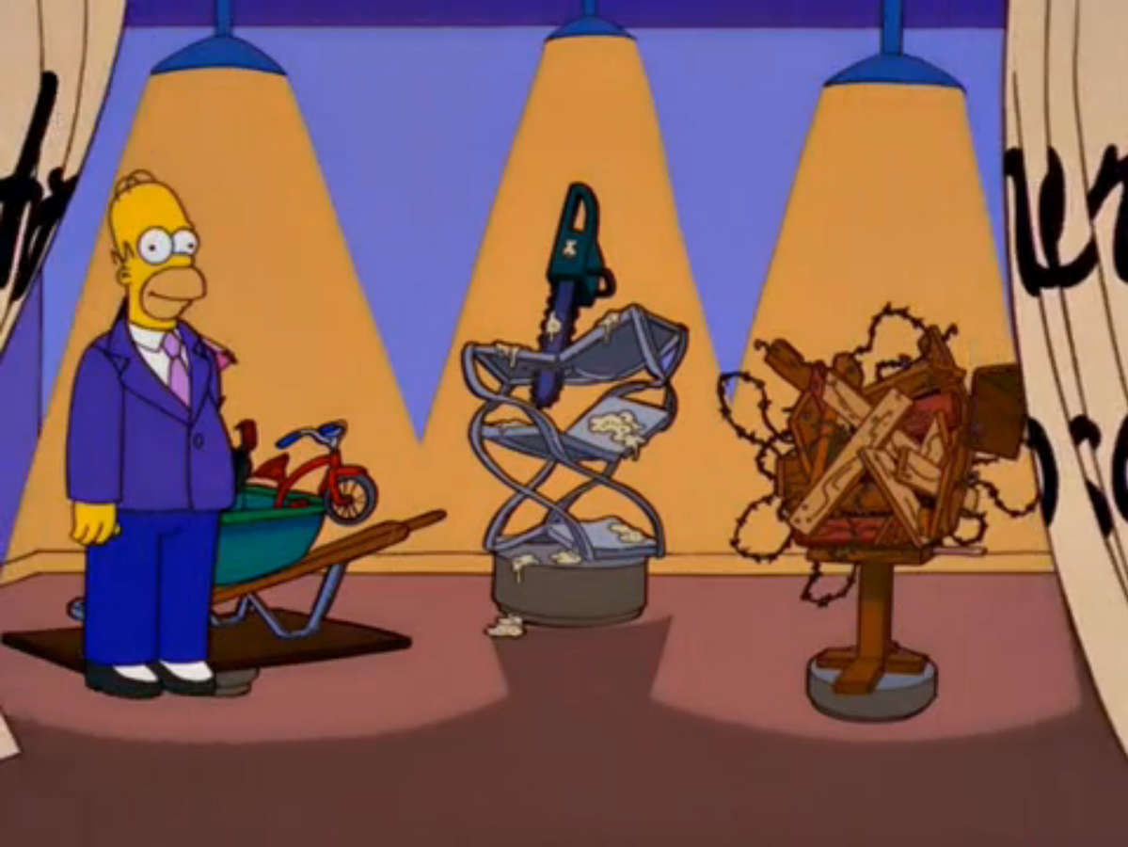
MY UNCONVENTIONAL CONTRIBUTIONS
04
 | ME
Using art to communicate what text or code cannot
Pushing open source outside of academia- public science
Expanding beyond the ‘super-user-to-developer’ profile
Notes:
Part 4: My unconventional start led to unconventional contributions. I use art to communicate what text or code cannot. While open source fuels powerful research, my focus is on open source outside of research, more for the public, to everyday users.

Slide 24
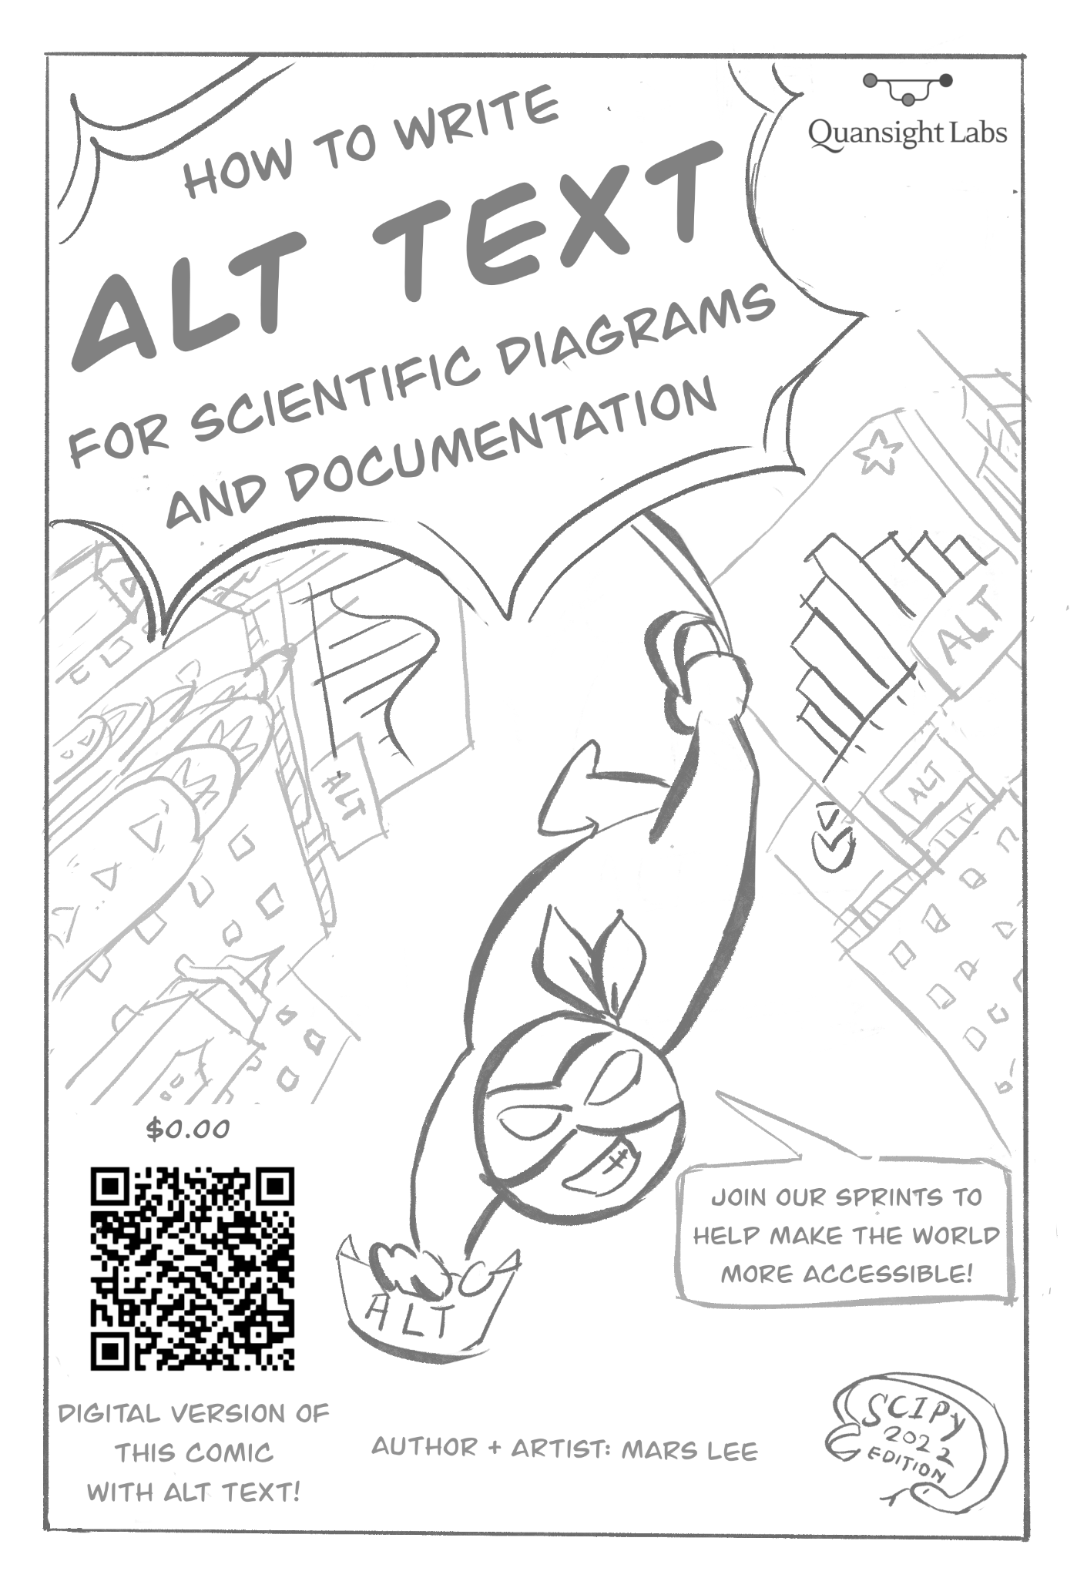
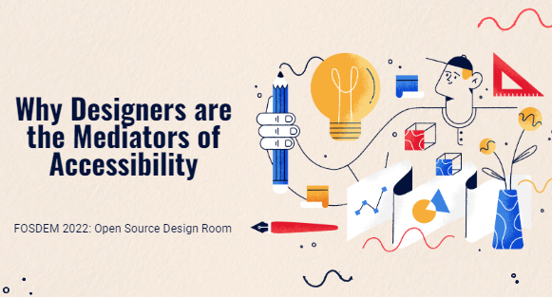

MY STRANGE CONTRIBUTIONS
04
Notes:
Like Homer Simpson here, I now have a gallery of contributions! If you go to the slides, you can click on each item and it’ll send you a page with more information. I have “Acessibiltiy- How to Write Alt Text for Scientific Diagrams and Documentation”! I co-host workshops of that topic! I’ve given talks about it too!

Slide 25
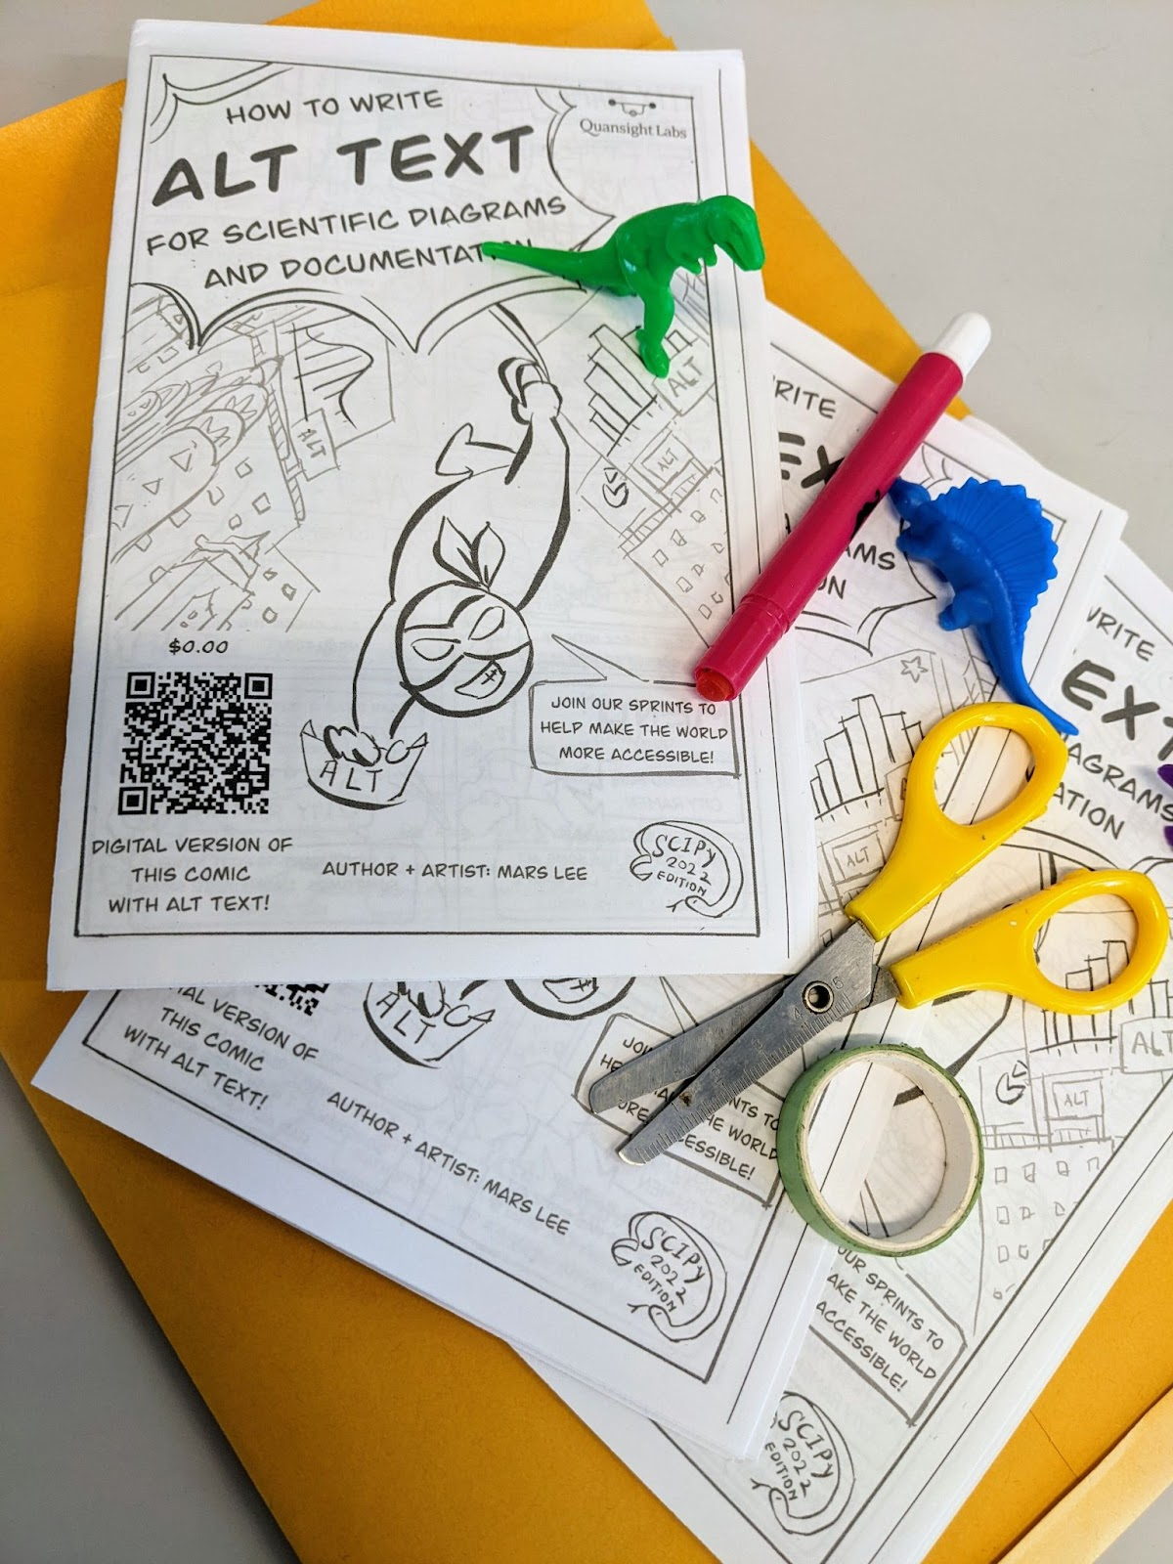
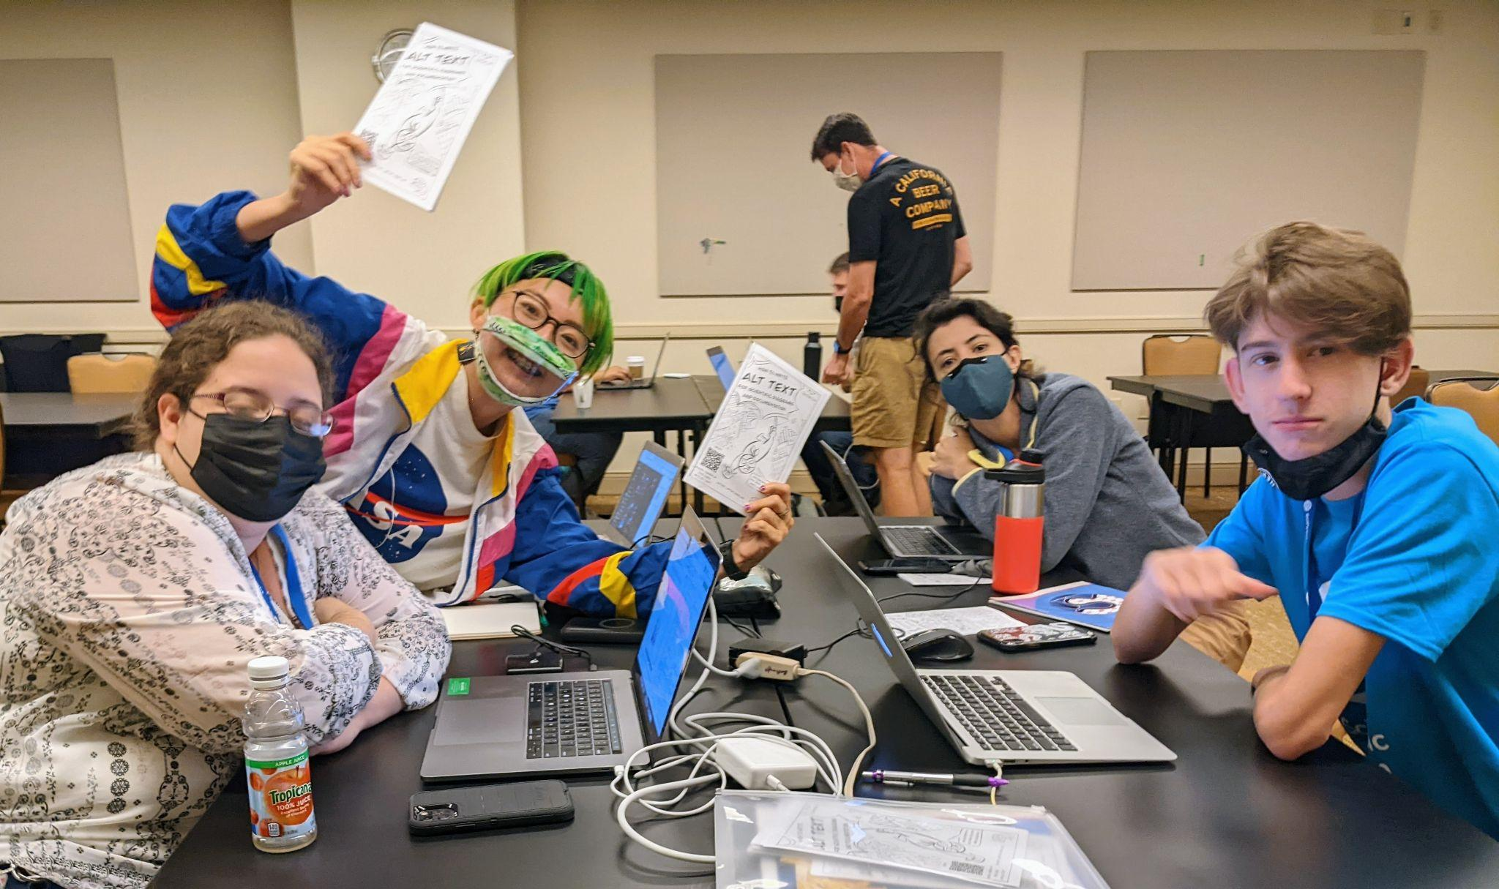
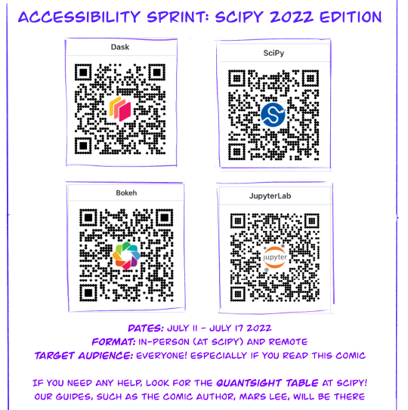
MY STRANGE CONTRIBUTIONS
04
Notes:
I’ve printed out physical copies of the comics at SciPy, an conference earlier this year! I led an accessibilite sprint at the conference, both inperson and remote!

Slide 26
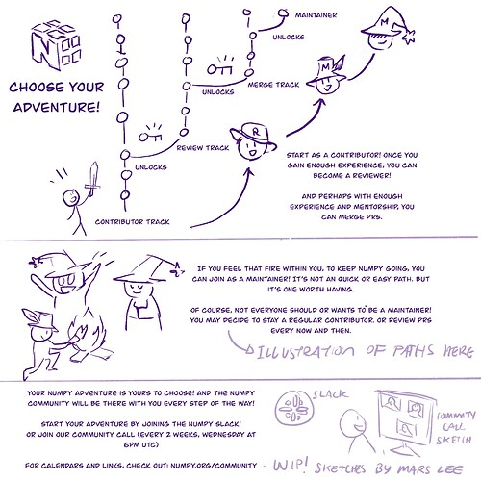
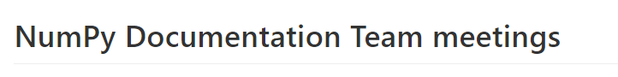
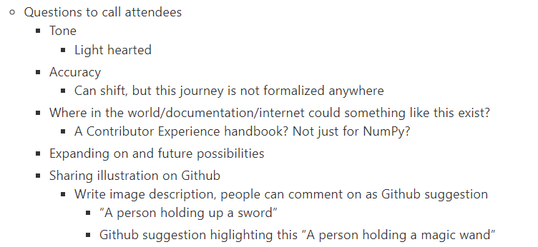
MY STRANGE CONTRIBUTIONS
04
Notes:
I have a rough draft of a NumPy Contributor’s Journey! I’m developing and getting feedback on it in the NumPY community calls!

Slide 27
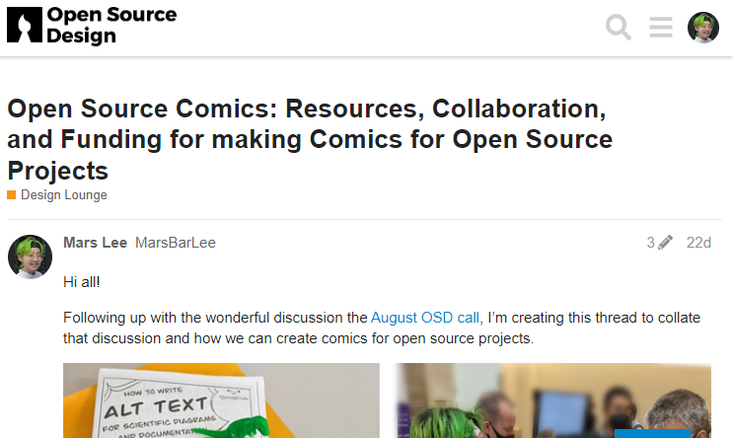
MY STRANGE CONTRIBUTIONS
04
Notes:
I’m talking to Open Source Design community as an artist!

Slide 28
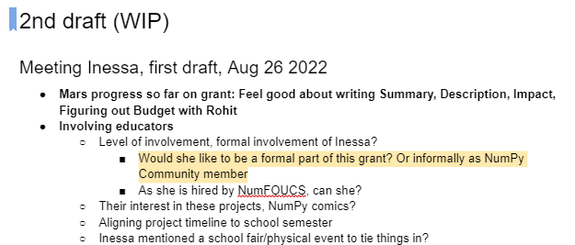

MY STRANGE CONTRIBUTIONS
04
Notes:
This wasn’t submitted, but I dipped my toes into grant writing! And I better understand how open source is funded in trying!

Slide 29
HOW YOU CAN START
05
04
If you already are a user of open source research software
Think:
How could this be better?
Could I make it better?
Notes:
Part 5: Enough bragging about me! What about you? How could you start? Well, if you already are a user of open source research software, think “How could I make this better?”

Slide 30

HOW YOU CAN START
05
04
If you already are a user of open source research software
Check out:
The project’s contributor’s guide
‘Good first issues’ tag on Github
Contributor’s
Guide
Notes:
You can check ouf the contributor’s guide or ‘Good first issues’ on Github

Slide 31
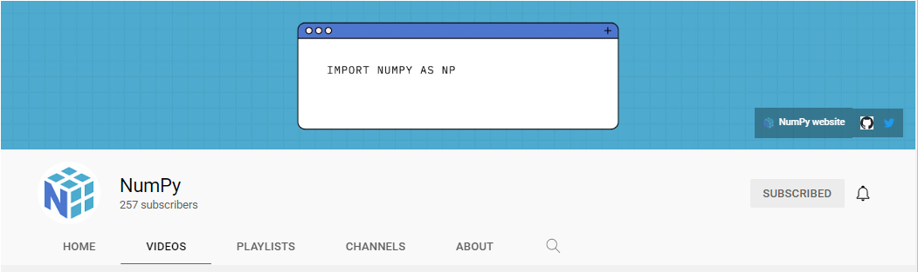
HOW YOU CAN START
05
04
If you want to start but don’t have a project in mind…
Join NumPy Newcomer Hour!
Every other Thursday, 2pm UTC
Alternates between hang out sessions and host talks
Talks on the NumPy Youtube Channel
Notes:
If you don’t have a project in mind… may I recommend you NumPy? I’m clearly biased, but I assure you, I have a good reason. A great place to start is the NumPy Newcomer Hour! It has both hang out sessions and talks. There’s a Youtube channel too!

Slide 32
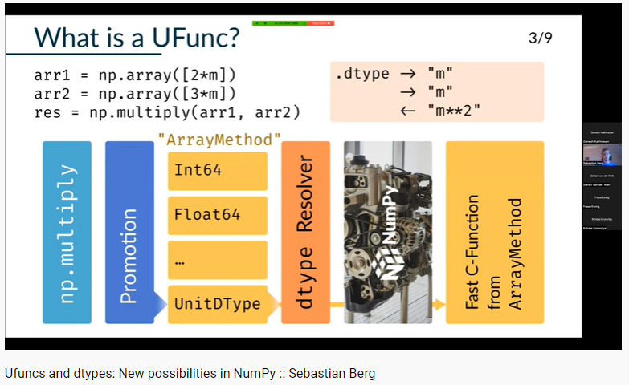
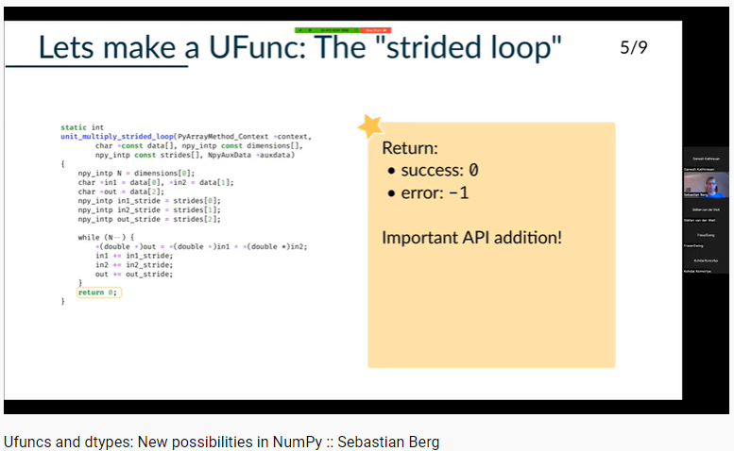
HOW YOU CAN START
05
04
If you want to start but don’t have a project in mind…
Join NumPy Newcomer Hour!
Ufuncs and dtypes: new possibilities in NumPy
Notes:
Some recent topics, by core maintainer Sebastian Berg, about ufuncs and dtypes! He goes through the codebase and explain how everything works together.

Slide 33
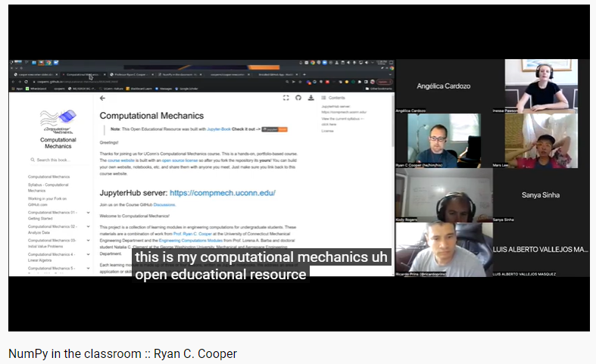
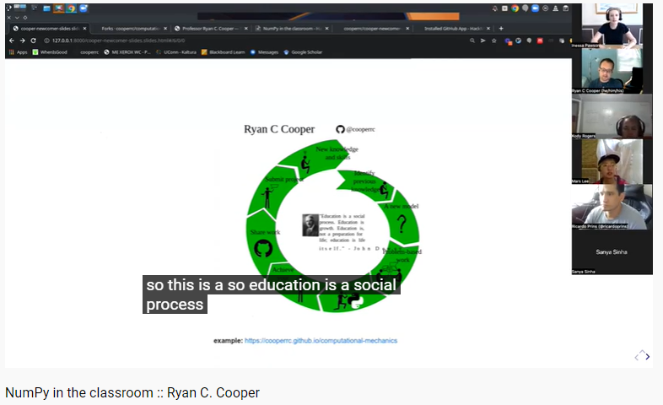
HOW YOU CAN START
05
04
If you want to start but don’t have a project in mind…
Join NumPy Newcomer Hour!
NumPy in the classroom: Open Curriculum for Universities
Notes:
We have Ryan Cooper on how we uses NumPy as part of an Open Curriculum to teach Applied Mechanics!

Slide 34
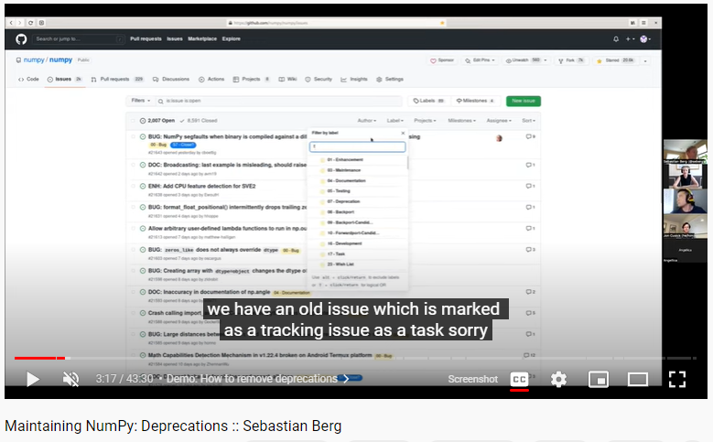
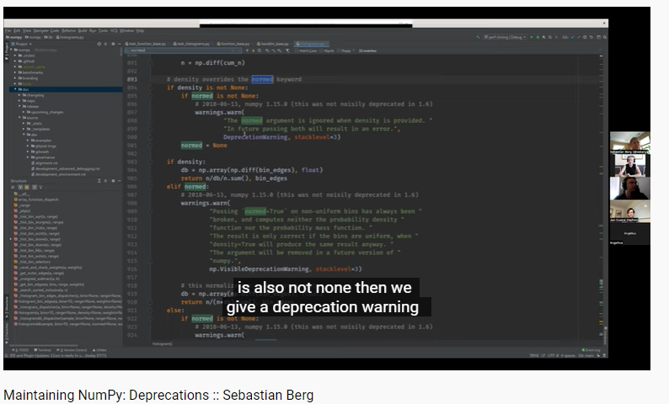
HOW YOU CAN START
05
04
If you want to start but don’t have a project in mind…
Join NumPy Newcomer Hour!
Maintaining NumPy: Deprecations
Notes:
Want to see how an important but also big codebase like NumPy is maintained, specifically with deprecations? Sebastian Berg has a video on that too! Clearly, NumPy Newcomers Hour are a great place to learn.

Slide 35
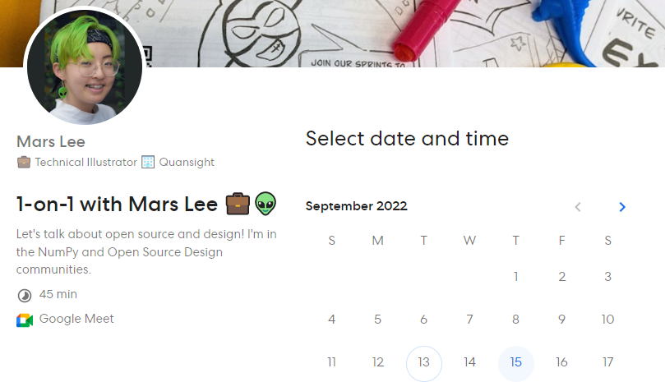
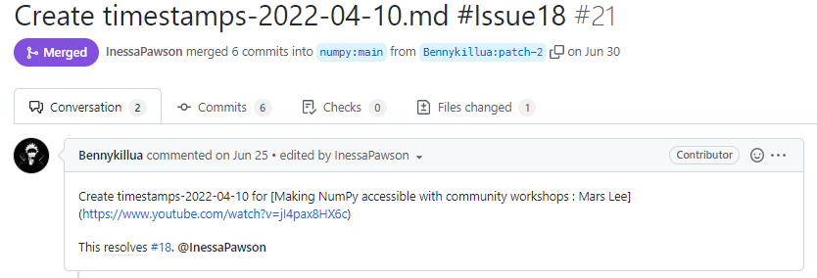
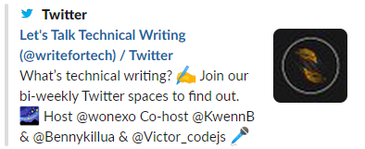
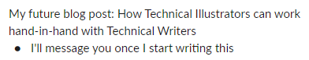
HOW YOU CAN START
05
04
If you want to start but don’t have a project in mind…
Creating Timestamps for NumPy’s videos
@Bennykillua!
Notes:
If you want to do a specific contributions, you could help add timestamps! This sections up the videos, making it easy for people to get an overview of the videos. Benny did a contribution, we set up a meeting and shared future collaborations!

Slide 36
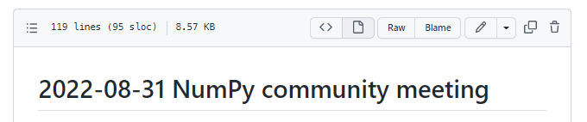
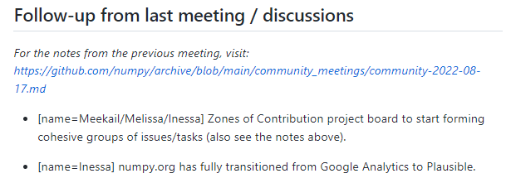
HOW YOU CAN START
05
04
If you want to start but don’t have a project in mind…
Write Meeting Notes for the NumPy Community Call
Currently, that’s me!
Soak up like a sponge: Get to know the contributor workflow, reviewers and maintainers before making your first contribution
Notes:
You could also write meeting notes. This way, you can sit in the back and soak up like a sponge. The contributor workflow, reviewers and more, to build up confidence.

Slide 37
OVERCOMING YOUR INSECURITIES
05
06
04
 | ME
Github account
Social media accounts
Personal website
Making a
Personal website
Notes:
Part 6: Overcoming your insecurities. The secret: We’re all figuring it out! Even though I’m here giving a keynote, I don’t have everything perfectly together. I have a Github account, a Twitter but… no personal website. Sort of embarrassing, but I’m showing you, hey, I’m still here! I’m still showing my face and moving forward.

Slide 38
FINDING STRENGTH AND SUPPORT
05
06
04
07
Unconference Board
Conference
Lobby
RSE Asia Australia Unconference 2023
Fellow contributors
Notes:
Part 7: Finding strength and support. I hope you can connect with other attendees in the Unconference Board, the Conference Lobby and projects. And perhaps, in next years Unconference, you will be the one giving the keynote?

Slide 39
YOUR UNCONVENTIONAL CONTRIBUTIONS
08
05
06
04
07
 | YOU
Your current skills + the skills you want to grow
The research and research software you want to see in the world
Connecting with open source community
Notes:
Lastly Part 8: Your unconventional contributions. Think what skills you have and want to grow. The research and software you want to see in the world. The communities you can connect with.

Slide 40




YOUR UNCONVENTIONAL CONTRIBUTIONS
08
05
06
04
07
Notes:
There’s different contributions you could do! You could translate and internationalize. You could host community events and chapters, like Saranjeet here did. You could design or write.

Slide 41




YOUR UNCONVENTIONAL CONTRIBUTIONS
08
05
06
04
07
Notes:
You could do user testing, accessibility, release management, and … hmmm, code perhaps?

Slide 42
YOUR UNCONVENTIONAL CONTRIBUTIONS
08
05
06
04
07
Recognize my privileges:
Compensated for my open source work
Live in North America, part of the Global North
No dependents
Notes:
However, I recognize my privileges: Compensated for my open source work, Live in North America, part of the Global North, No dependents. So it’s easier in terms of money, timezones, responsibilities, for me to make the work I do.

Slide 43
YOUR UNCONVENTIONAL CONTRIBUTIONS
08
05
06
04
07
Notes:
So while I recognize my work as unconventional… it’s still shaped and limited by my skills and privileges.

Slide 44
YOUR UNCONVENTIONAL CONTRIBUTIONS
08
05
06
04
07
Notes:
I invite you, attendee, to think of your skills. What you have that’s different from and other contributions. How we could make open source projects more mature, well rounded and diverse. Represent the world, for Nothing About Us Without Us

Slide 45
AN UNCONVENTIONAL START:
OPEN SOURCE
HOW
WILL OPEN YOUR OPPORTUNITIES
Notes:
And congratulations! You’ve reached the end of my keynote! I have pulled back the curtains and revealed the true nature of this talk. That it is you, you that can have an unconventional start and that open source will open your opportunities. Hahaha!

Slide 46
THANK YOU!
Thank you to:
RSE Asia Australia Unconference Organizers
Saranjeet Kaur
Paula Martinez
Open Source Design community
Belén Barros Pena
Eriol Fox, Bernard Tyers, Jan Dittrich, Juhan Sonin and more!
NumPy Community
Melissa Weber Mendonça
Inessa Pawson
Credits: This presentation template was created by Slidego, including icons by Flatiron, and infographics by Freepik
Notes:
So thank you. Thank you for attending. Thank you organizers, specifically Saranjeet and Paula. Thank you NumPy community, Melissa and Inessa. And thank you Open Source Design, Belen, Eriol, Bernard, Yan, Juhan and more!

Slide 47
LET'S CONNECT!
@marsbarlee
linkedin.com/in/mars-lee/
mlee@quansight.com
Email me if you like to book a short meeting with me!
Notes:
If you would like to connect, you can check out my Twitter ad LinkedIn. If you like to meet me, send me an email and we can set up a date! Thank you!

